Slide 1
project
WEB-BASED APPLICATION FOR FOOD WASTE MANAGEMENT

Slide 2
BATCHMATES
Ranjith S
Kaja Mohaidheen I
Dharaneesh S R
Title :
WEB-BASED APPLICATION FOR FOOD WASTE MANAGEMENT

Slide 3
Objective
This can assist in collecting the leftover foods from marriage-halls or parties and to distribute among those in need.

Slide 4
Modules
In this system there are 4 modules :
1.Admin
2.Donor
3.NGO
4.Logistics
1.Admin :
Admin will receive the requests of Donor, NGO and Logistics.
Admin can Accept or Deny the requests.
Admin can map the NGO and Logistics.

Slide 5
Modules
2.Donor :
Donor will raise the request,
Can view the raise,
Can view the status.
3.NGO :
NGO will raise the request with Location, and No.Of.food packet needed.
Can view the raise and status.

Slide 6
Modules
4.Logistics :
Logistics can raise request by their location, vehicle type and number.
Can view the status.
Can view the raise.
These are the 4 modules.

Slide 7
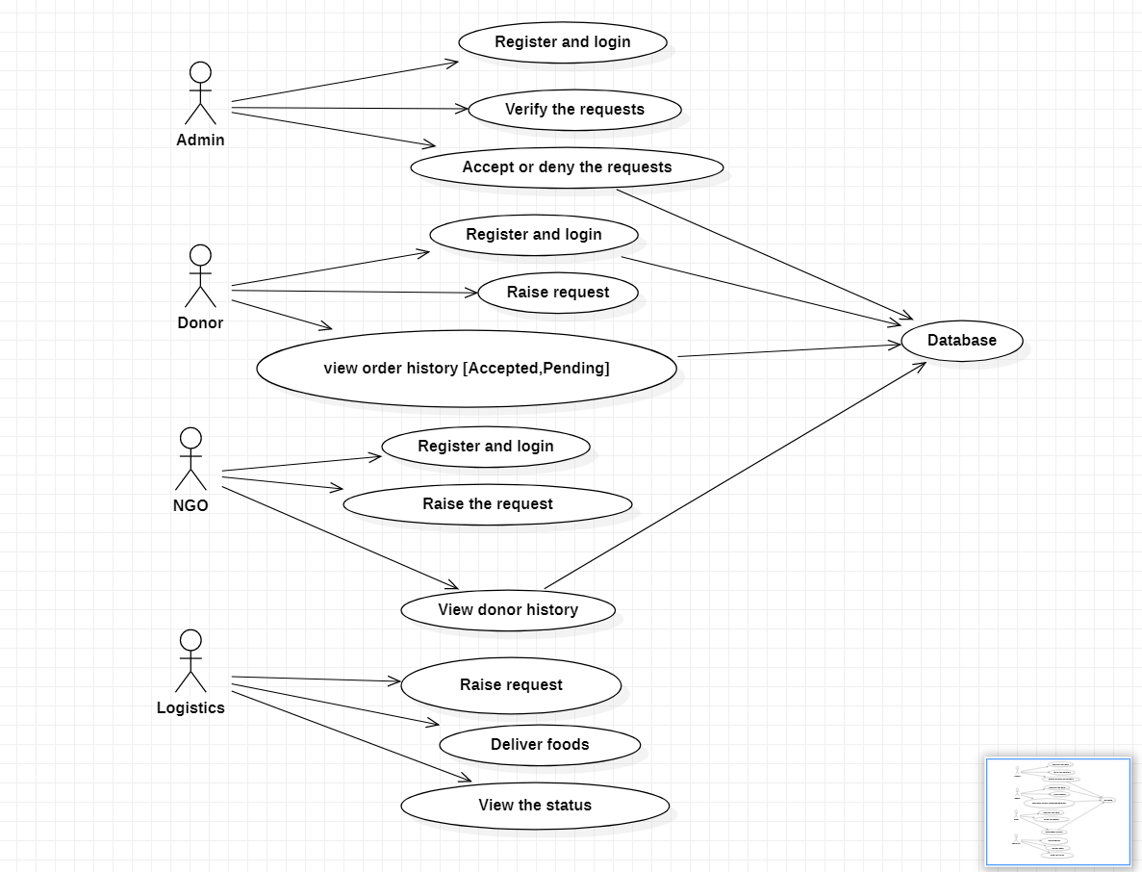
Flow diagram

Slide 8
Existing and Proposed System
Existing System :
Donors and NGOs will communicate with calls.
Difficult to find donors or NGOs even there is availablity.
Proposed System :
Donors and NGOs can find them easily with the work of admin.
Delivery persons known as logistics will also get login for their purposes.

Slide 9
Software and Hardware requirements
Hardware :
Running PC with minimum of 4gb ram
Software :
HTML
CSS
JSP for frontend
HeidiSQL
MySQL for backend
Netbeans with apache tomcat for execution.

Slide 10
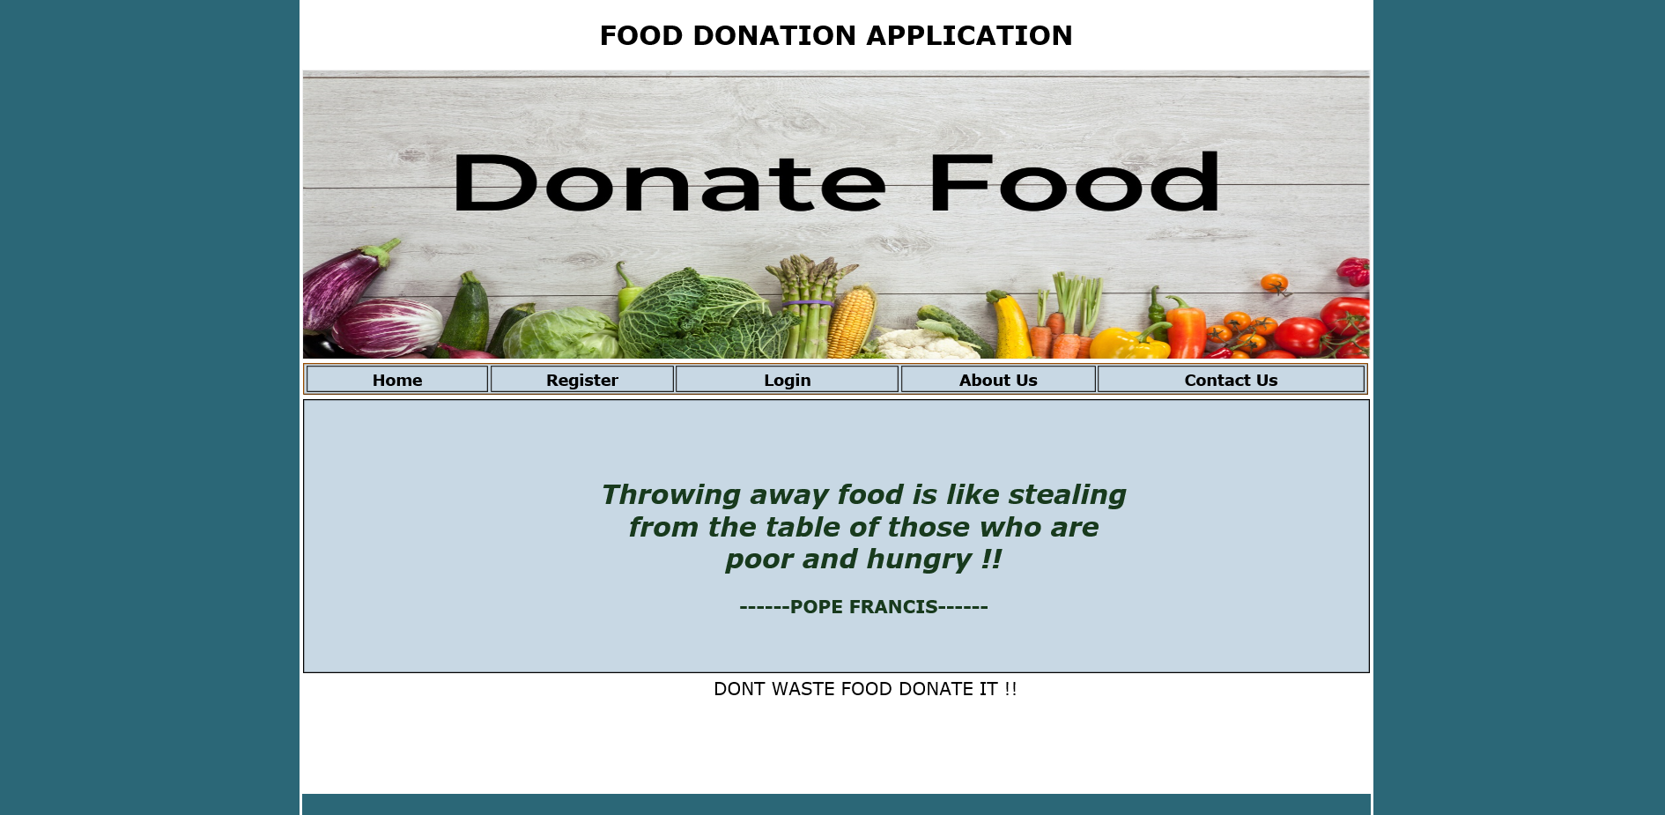
OUTPUTS

Slide 11
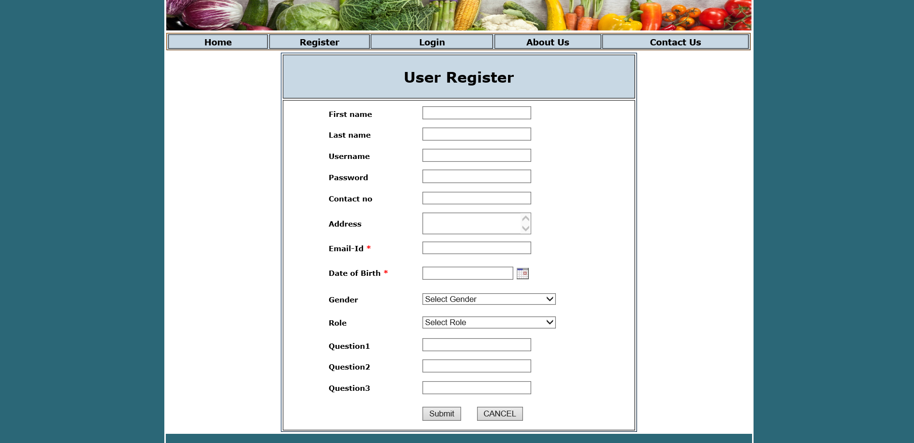
OUTPUTS

Slide 12
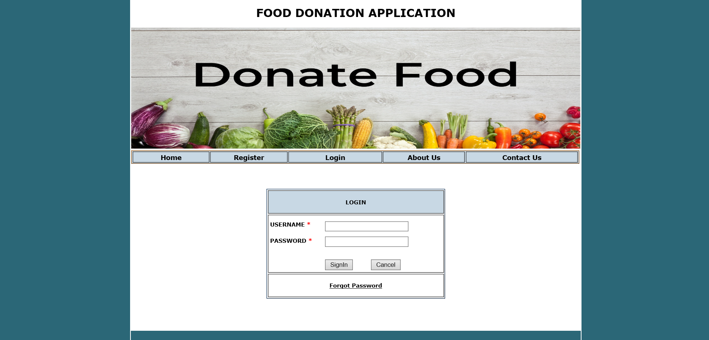
OUTPUTS

Slide 13
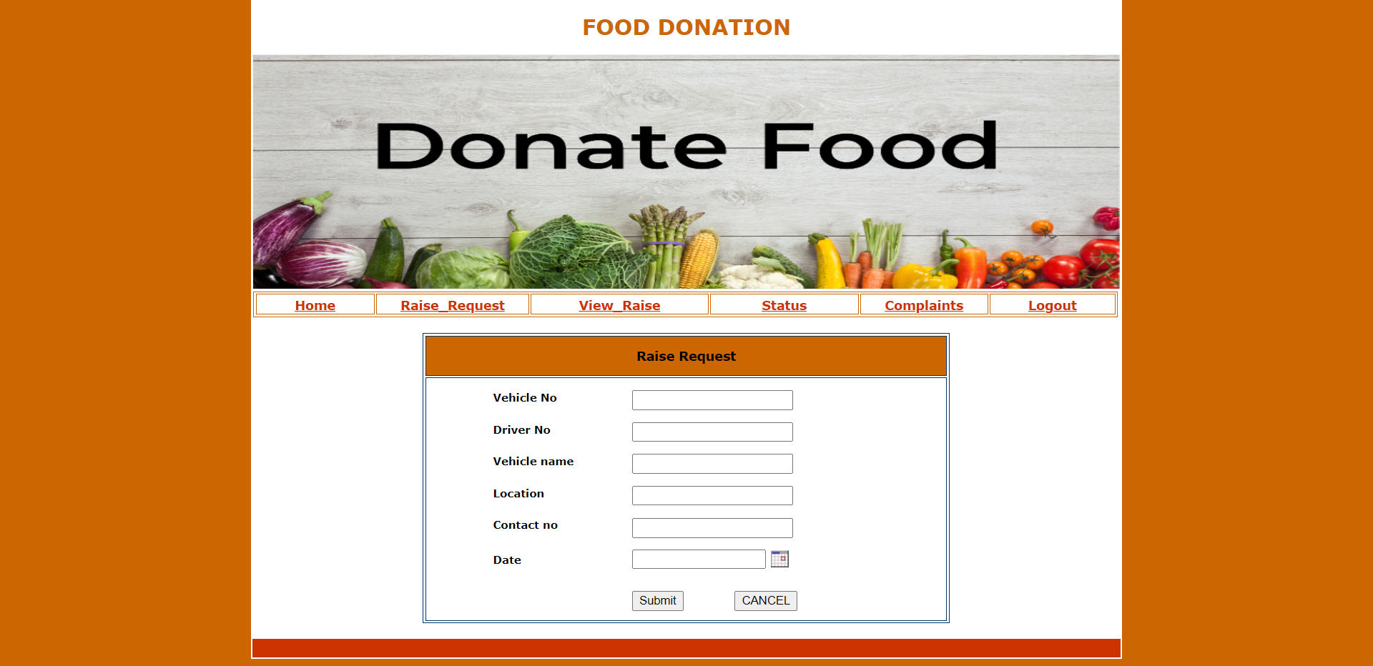
Outputs

Slide 14
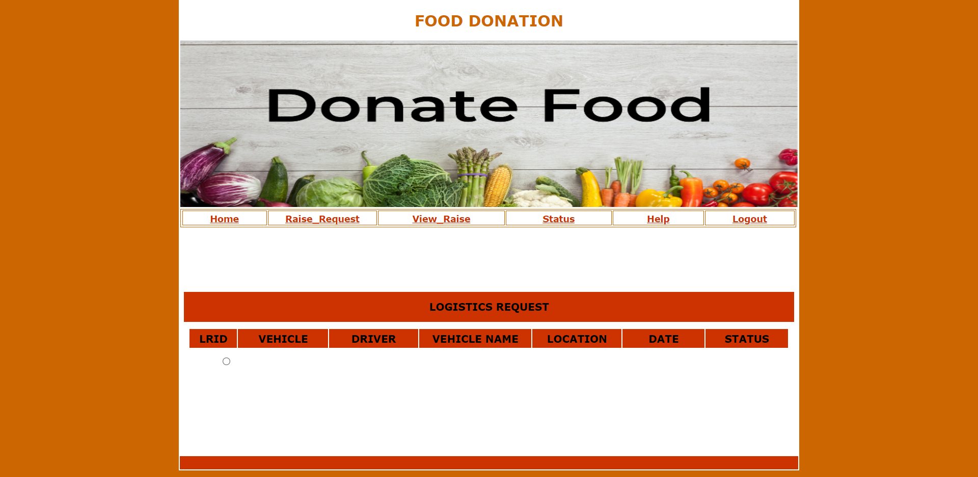
Outputs

Slide 15
THANK YOU

